Slide 1
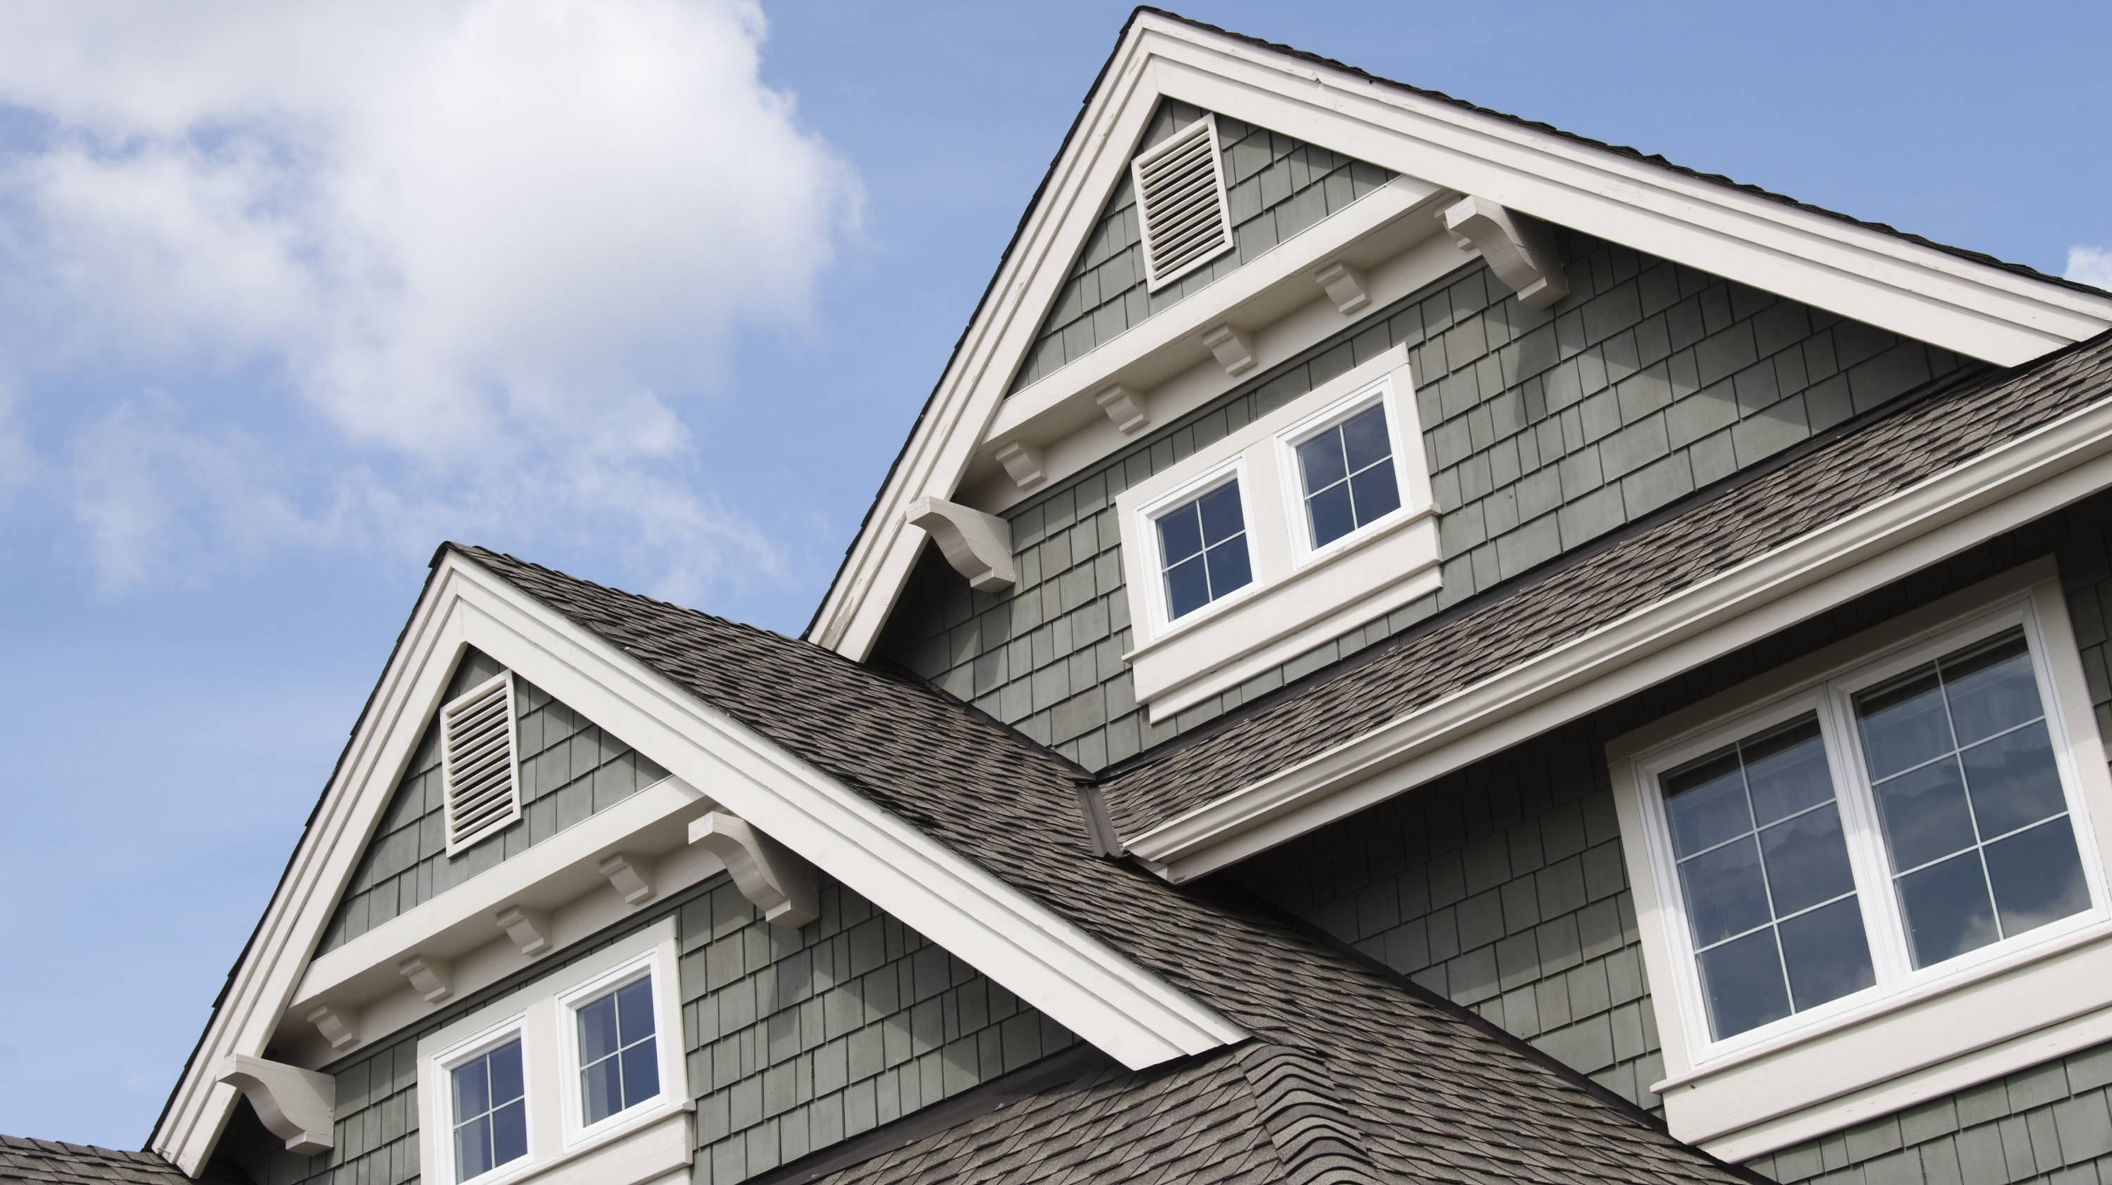
Statistical Analysis of Ames, Iowa Home Sales
Presented by Alexandra Watson

Slide 2

Project Goal…
What factors drive home sales? Do the materials used to fabricate a home in Ames Iowa affect the sale price?
Such as Brick face exteriors?
Such as concrete and concrete slab foundations?

Slide 3
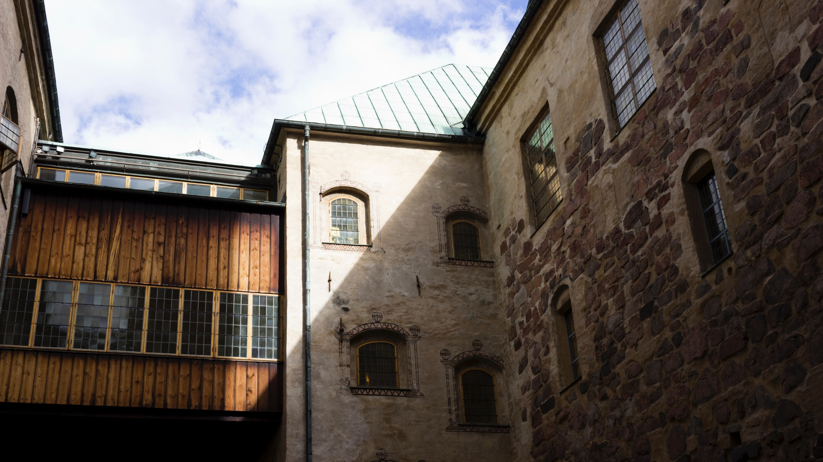
Hypotheses 1
NULL Hypothesis 1 (H₀): A home with a brick face exterior does not increase or decrease a home's value compared to other materials used for the exterior in Ames, Iowa.
Alternate Hypothesis 1 (H_{a}): Houses with a brick-face exterior do affect the home’s value more than homes without a brick-faced exterior in Ames, Iowa.

Slide 4
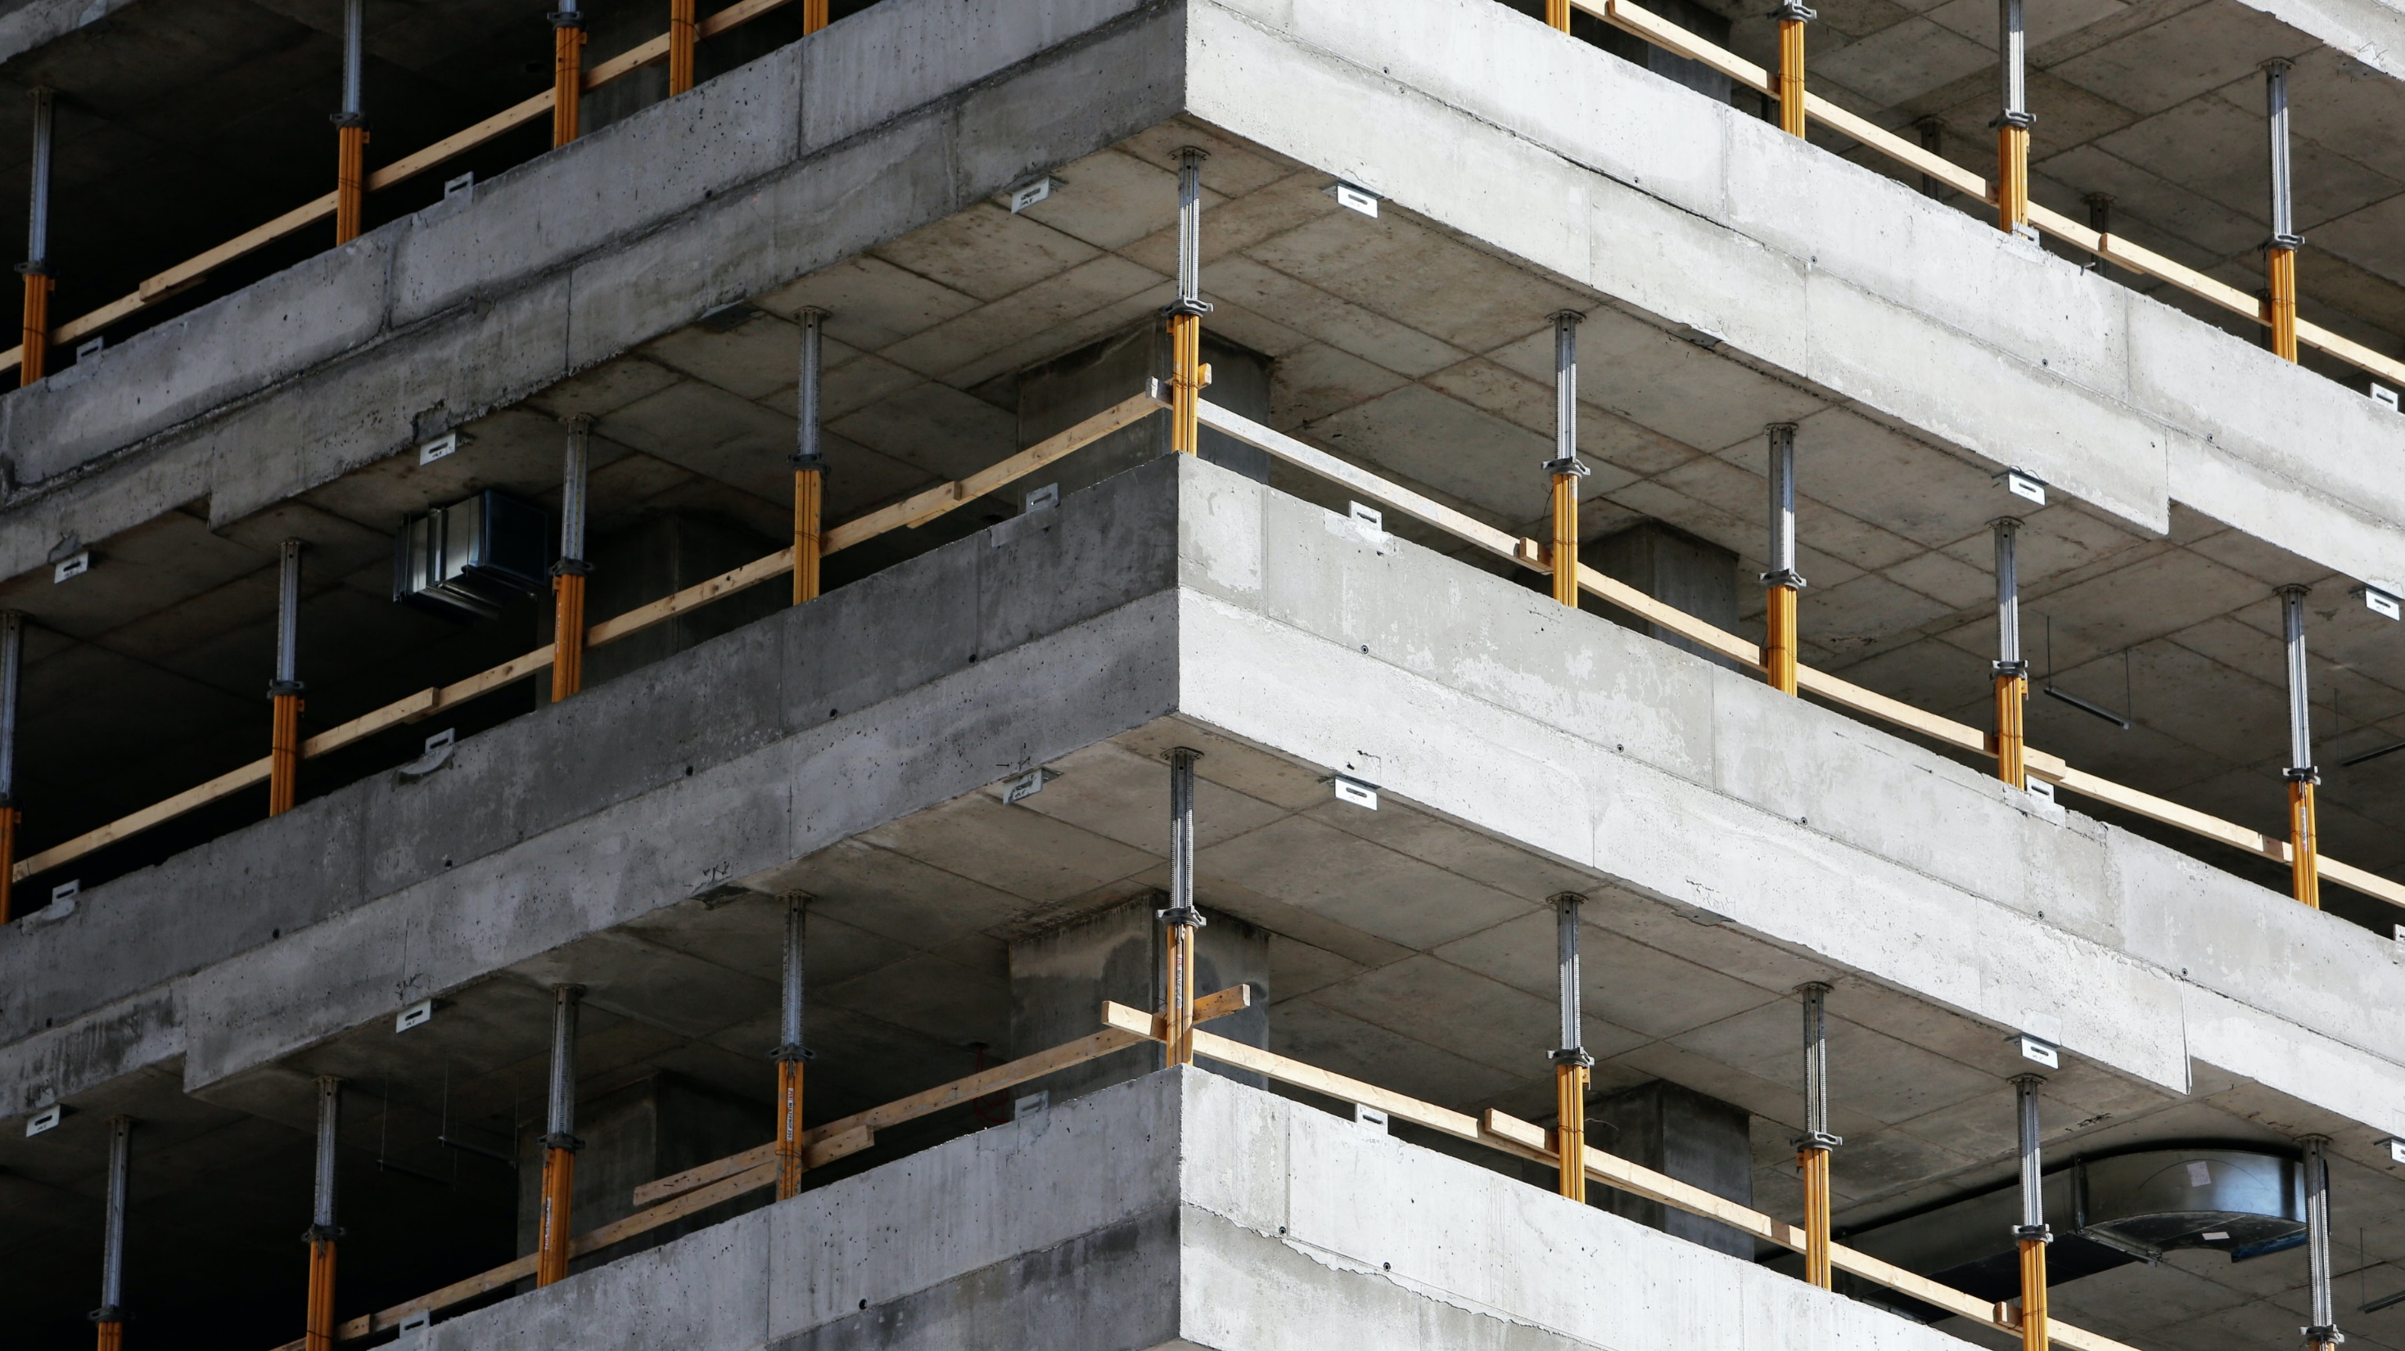
Hypotheses 2
NULL Hypothesis 2 (H₀): A concrete or concrete slab as a home’s foundation does not affect the home’s value in Ames Iowa.
Alternate Hypothesis 2 (H_{a}): Concrete or concrete slab foundations influence the value of a home compared to other foundation types in Ames, Iowa.

Slide 5
The process
Data is collected about what type of foundations the homes in Ames, Iowa have. Along with data about the materials used to fabricate the exterior of each home.
Statistical analyses is done to if there is any significant statistical difference in the sale price of homes with Brick face exteriors. If there is any significant statistical difference in homes with concrete slab foundations sale price.

Slide 6
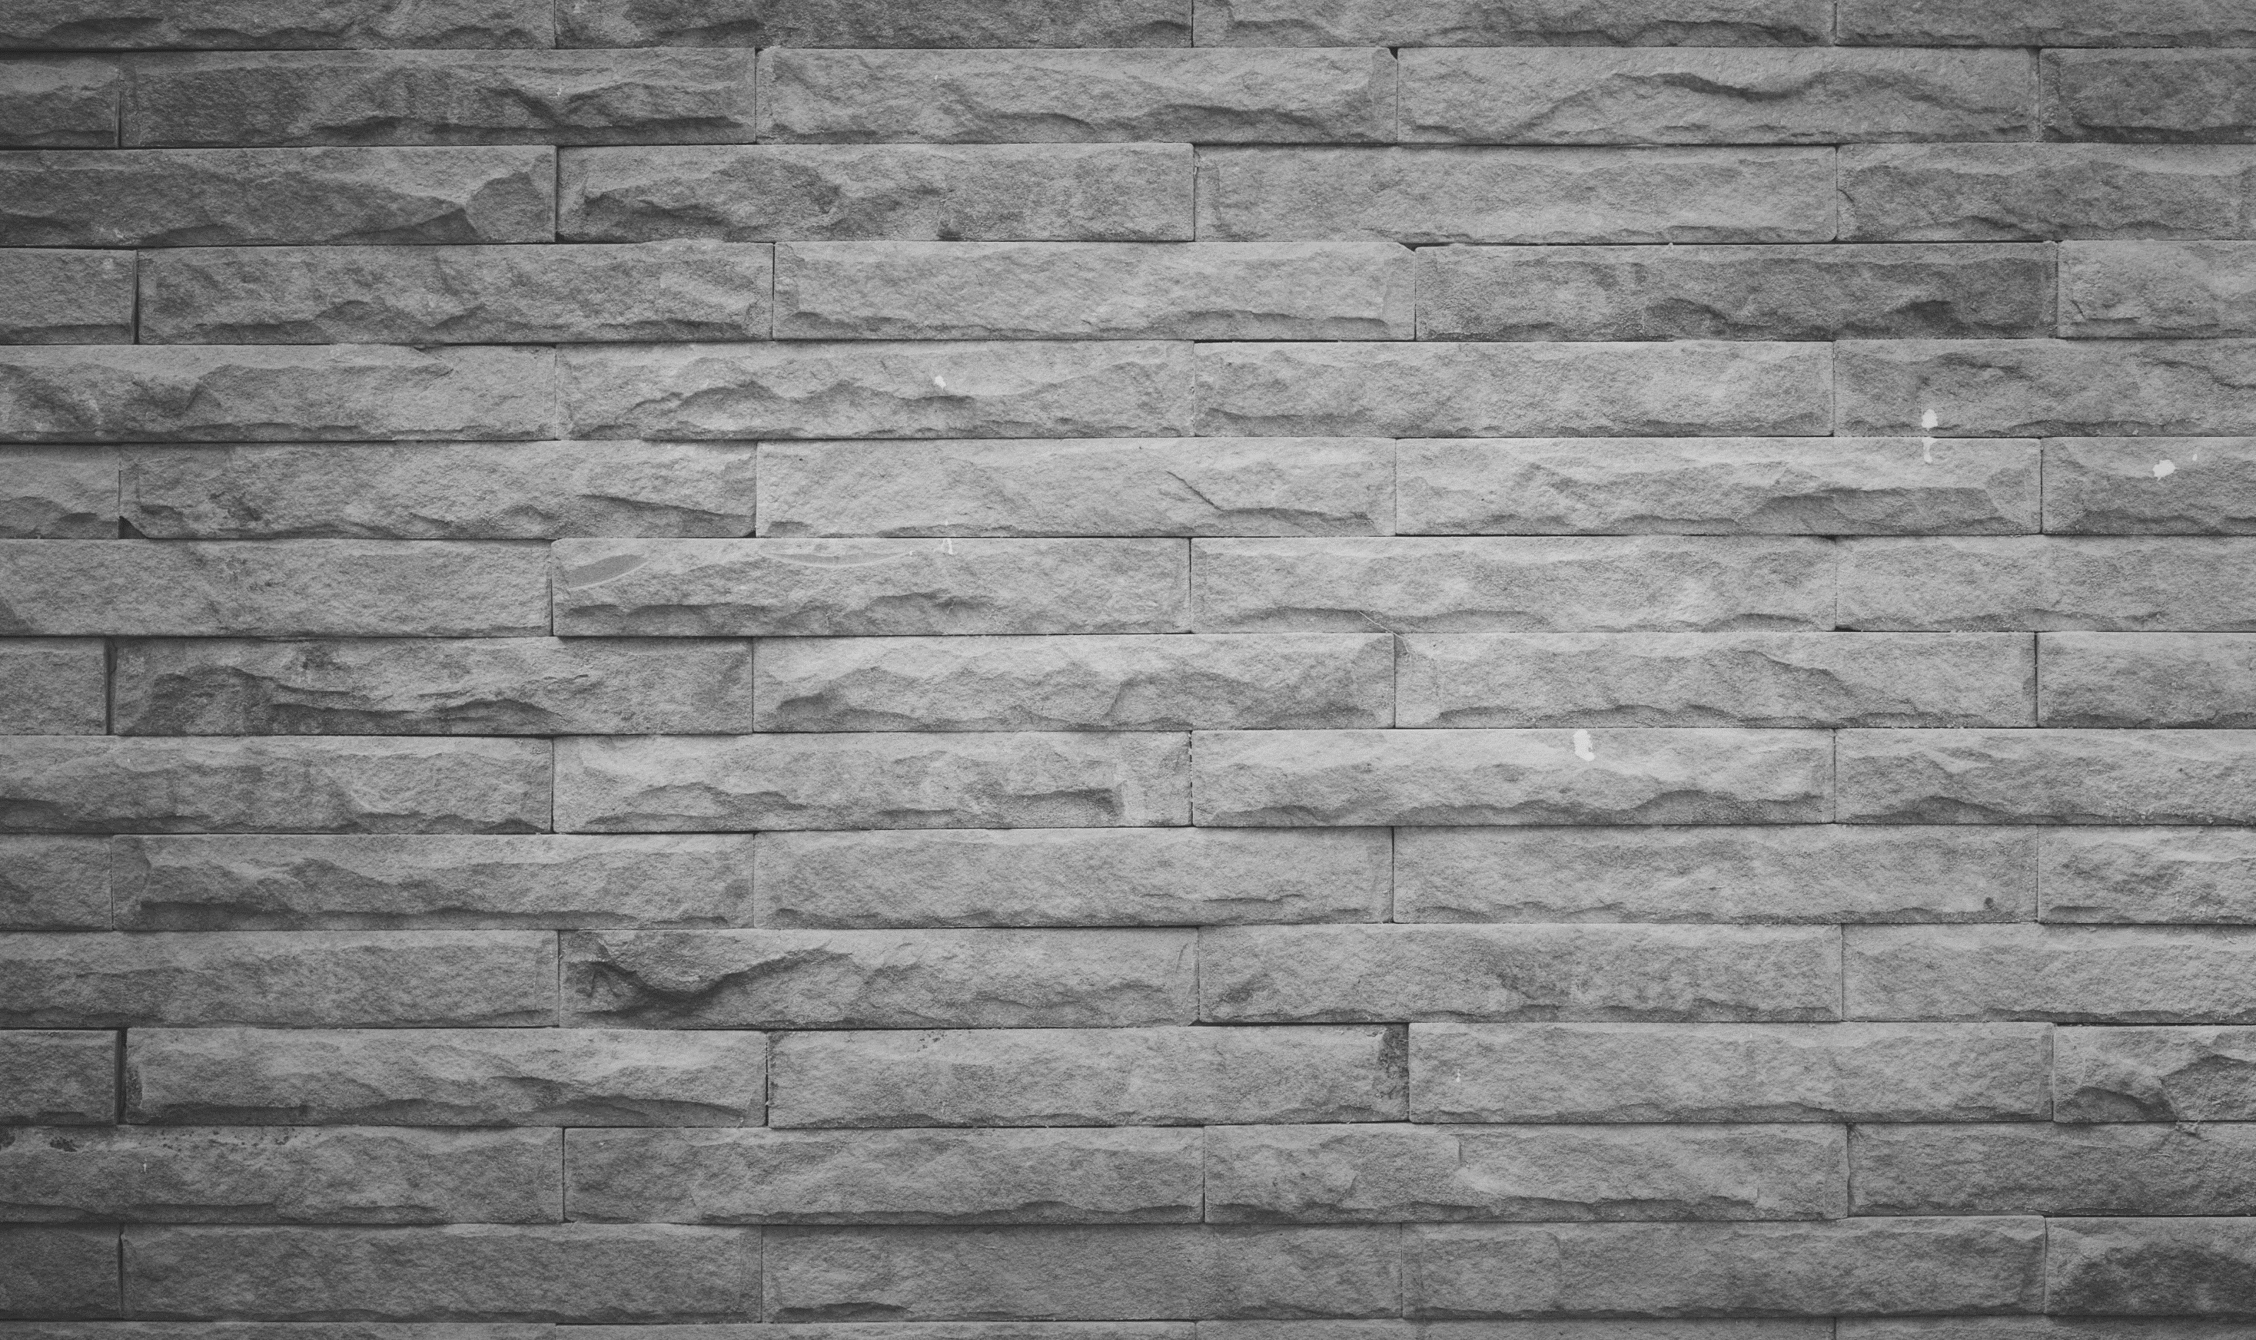
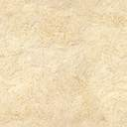
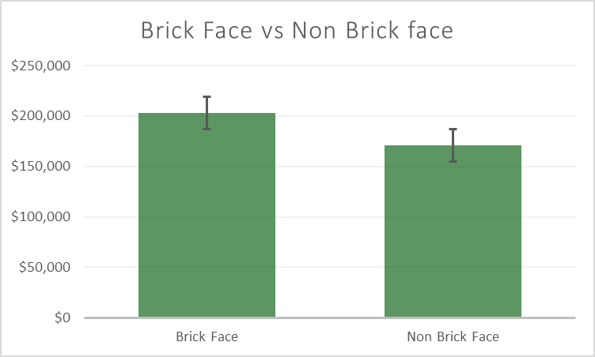
Analysis of Brick face exteriors
Conclusion: The null hypothesis is rejected. There is a significant difference between brick-faced exterior homes’ value and non-brick-faced homes’ sale prices.

Slide 7
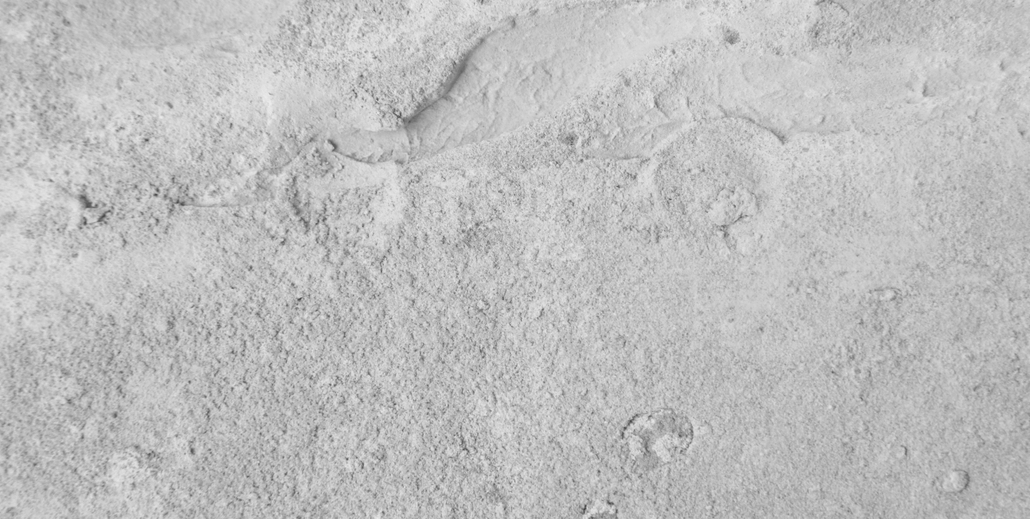
Analysis of concrete slab foundations
Conclusion: The null hypothesis is rejected. There is a significant difference between concrete slab foundation homes’ value and non-concrete slab foundation homes’ sale prices.

Slide 8
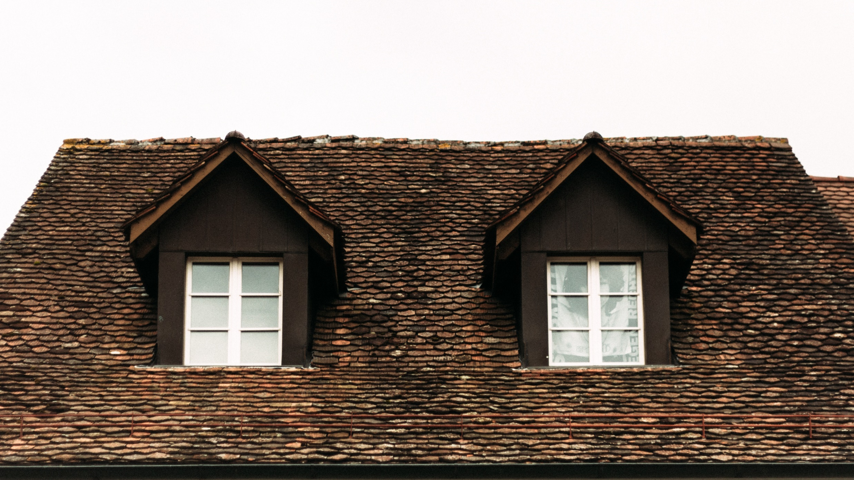
Recomendations

Slide 9

The results of the hypothesis are based on the P value ( 2.36652E-12 ). There is statistical significance in the value of home sales with a brick-face exterior. We can reject the null hypothesis.
My recommendation is to mark these homes at a higher value than those without a brick-faced exterior

Slide 10
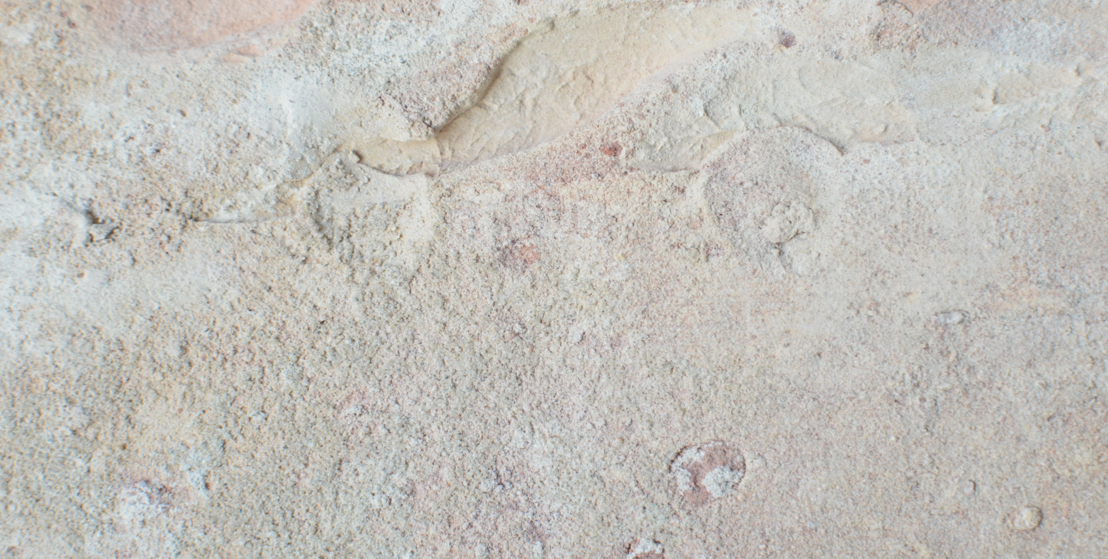
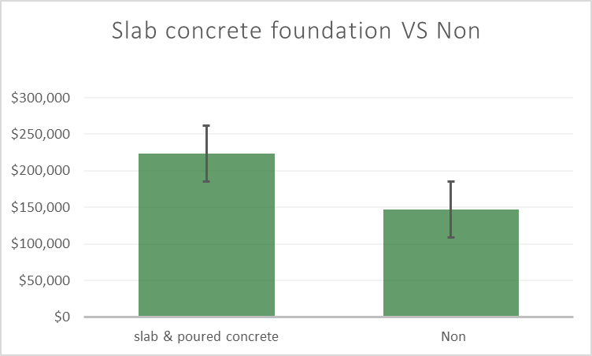
The results of the hypothesis are based on the P value ( 2.46792E-54 ). There is statistical significance in the value of home sales with Concrete and poured concrete slab foundations. We can reject the null hypothesis
My recommendation is to mark these homes at a higher value than those with other foundation types.

Slide 11
A Statistical Analysis of Ames, Iowa Home Sales
Presented by Alexandra Watson
Thank you..

